Slide 1

Text Sentiment Analysis
Abhay Singh Kachawaha (1900560130001)
Aditya Singh (1900560130002)
Aniket Singh (1900560130007)
Jai kishan Gupta (1900560130017)

Slide 2

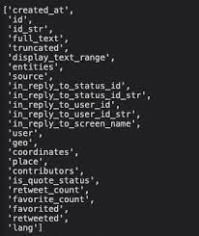

Text sentiment analysis, also known as opinion mining or emotion AI, is the process of identifying and extracting subjective information from text data. It involves using natural language processing (NLP) techniques and machine learning algorithms to analyze text data and classify it as positive, negative, or neutral based on the sentiments expressed in the text.

Slide 3
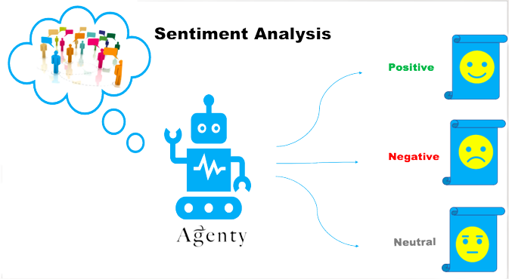
Process of Text Sentiment Analysis
Extract
Pre-processing
Tokenization
Stemming
Vectorization
Model training
Model evaluation
Model deployment

Slide 4

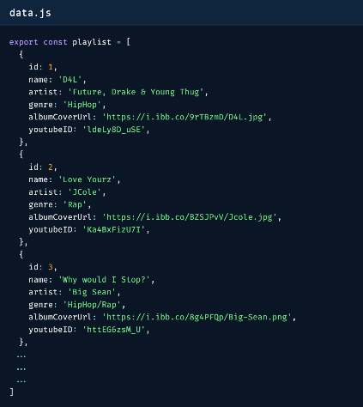

Data Extraction
An API can be used to extract data from a website or database, as well as to send data to a website or database.
Tweets
json
API

Slide 5
Pre-processing
Preprocessing the text data is an important step in any natural language processing (NLP) task. It involves cleaning and preparing the text data for further analysis. This includes removing any special characters, symbols, and numbers, and converting the text to lowercase. It may also include removing stop words
"The quick brown fox jumps over the lazy dog."
"quick brown fox jumps lazy dog."
Work in Pre-processing :
Removing special characters, symbols, and numbers.
E.g., “The quick brown fox jumps over the lazy dog.“
Converting the text to lowercase
E.g., "happy" and "Happy" are both converted to "happy“
Removing stop words
Examples of stop words include "a," "an," and "the."

Slide 6
Tokenization
Tokenization is the process of splitting the text into individual words or tokens. It is an important step in natural language processing (NLP) as it helps to split the text into individual units that can be analyzed and processed.
quick
brown
"quick brown fox jumps lazy dog."
fox
jumps
lazy
dog
Importance of Tokenization :
It helps to break down the text into smaller, more manageable pieces that can be more easily analyzed and processed.
It allows you to focus on individual words or tokens rather than the entire text, which can be helpful when working with large
or complex datasets.
It can help to improve the performance of machine learning models by reducing the dimensionality of the data.
It allows you to apply specific processing or analysis techniques to individual words or tokens, rather than the entire text.

Slide 7

Stemming
Stemming is the process of reducing a word to its base or root form. In the context of text sentiment analysis, stemming can be used to group similar words together and reduce the dimensionality of the data.
“jumping”
“jumps”
“jumped”
Importance of Stemming:
“jump”
It helps to reduce the dimensionality of the data by grouping similar words together.
It allows you to focus on the meaning of a word rather than its specific spelling.
It can help to improve the accuracy and effectiveness of certain NLP tasks, such as text classification and information retrieval.
It can make it easier to compare and analyze words across different documents or datasets.

Slide 8

Vectorization
Vectorization is the process of converting text data into numerical vectors or matrices that can be used in machine learning algorithms. It is an important step in natural language processing (NLP) as it allows you to input text data into machine learning models, which typically expect numerical input.
Term frequency-inverse document frequency (TF-IDF) :
Calculate by multiplying the term frequency (TF), which is the number of times a word appears in a document.
Inverse document frequency (IDF), which is a measure of how common the word is across all documents.
Words that are more common across all documents will have a lower IDF, while words that are more
specific to a particular document will have a higher IDF.

Slide 9
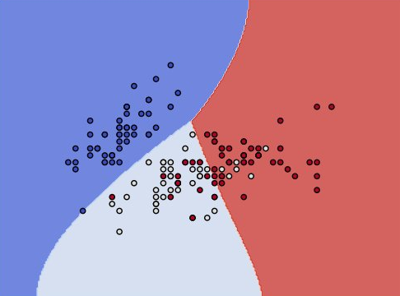



Model training
Machine learning algorithms to train a model to classify the text as positive or negative based on the sentiments expressed in the text.
Algorithm we are using for analysing text sentiments is Support Vector Machine(SVM)
Use an SVM to train a model to classify the text as positive or negative.
To do this, you will need to split your dataset into a training set and a validation set
And use the training set to train the model and the validation set to evaluate the model's
performance and tune its hyperparameters.

Slide 10




Model evaluation
Model evaluation is the process of assessing the performance of a machine learning model on a given dataset. It is an important step in the machine learning process because it helps determine how well the model generalizes to unseen data and can identify areas where the model may be lacking.
Methods for evaluating a machine learning model :
Accuracy is the proportion of correctly classified examples.
Precision is the proportion of predicted positive examples that are actually positive.
It is a measure of the model's ability to avoid false positives.
Recall is the proportion of actual positive examples that are correctly predicted as positive. It is a measure of the model's
ability to find all the positive examples in the dataset.
F1 score is a combination of precision and recall, and it is calculated as the harmonic mean
of precision and recall. It is a useful metric when you want to balance precision and recall.

Slide 11



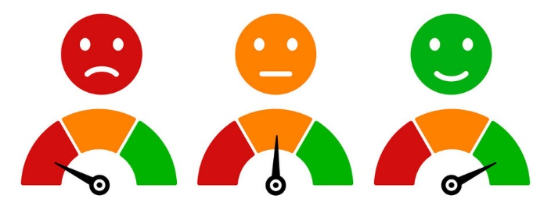
Model deployment
If the model performs well on the test dataset, it can be deployed in a production environment to classify new text data as it comes in. This may involve setting up a web server or API to accept incoming text data and return the predicted sentiment.

Slide 12

"Public sentiment is everything. With public sentiment, nothing can fail. Without it, nothing can succeed“ ~~ Abraham Lincoln
Thank You…….

